Slide 1
Foreign Exchange Market
By: Megan Gilson and Brian hill

Slide 2
Gold Standard

Slide 3
Bretton Woods System
The US dollar was the basis for all participating countries comparative value whereas the US dollar was the only one backed and measured by gold.

Slide 4
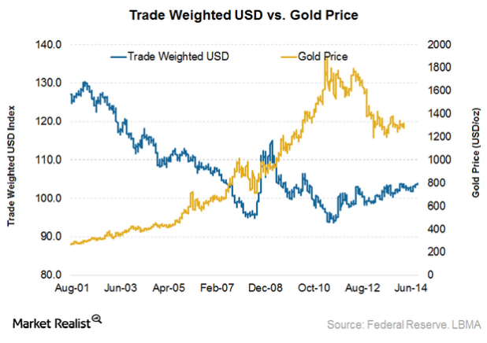

Slide 5
Forex Market
Is a global and decentralized market made for the trading of currencies.

Slide 6
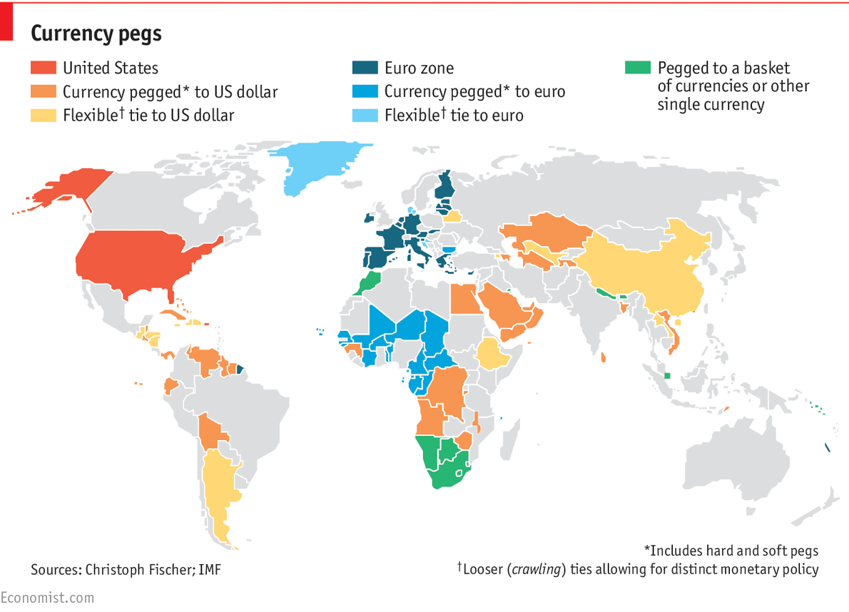

Slide 7
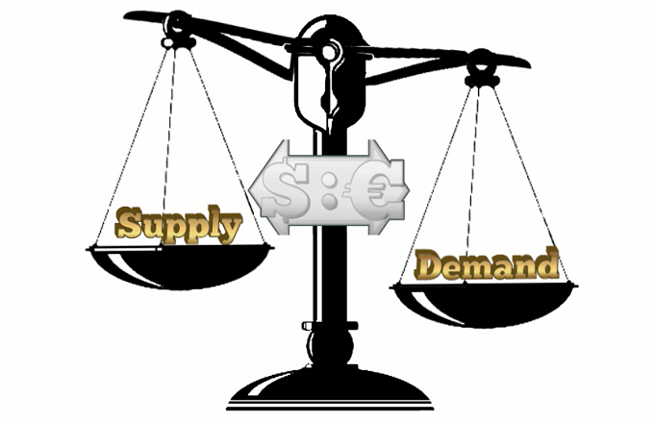
Managed floating rate system

Slide 8
Free Floating

Slide 9
Spots and Futures
Spot Rates
This is where buyers pay in a different currency to purchase another currency
The spot exchange rate is the earliest value date, which is usually about two business days after the transaction
Financial Speculation vs Trading

Slide 10
Forex Hours
24 Hours a day
New York 8am to 5pm EST Tokyo 7pm to 4am EST Sydney 5pm to 2am EST London 3am to 12 noon EST
Prime times
Tokyo and Sydney- 7pm to 2am
Tokyo and London- 3am to 4am
New York and Sydney- 5pm
New York and London- 8am to 12pm

Slide 11
Foreign Exchange turnover By Currency
By Currency | Total | Spot Transactions | Foreign exchange swaps
USD | 4,438 | 1,385 | 2,160
EURO | 1,591 | 519 | 807
JPY | 1,096 | 395 | 458
GBP | 649 | 211 | 305
AUD | 348 | 143 | 138
CAD | 260 | 105 | 103
CHF | 243 | 57 | 150
CNY | 202 | 68 | 86
SEK | 112 | 34 | 59
Other Currencies | 1,195 | 388 | 409

Slide 12
Foreign Exchange turnover by country
By Country | Total | Spot Transactions | Foreign exchange swaps
United Kingdom | 2,406 | 784 | 1,161
United States | 1,272 | 581 | 391
Singapore | 517 | 122 | 248
Hong Kong SAR | 437 | 92 | 276
Japan | 399 | 110 | 206
France | 181 | 23 | 137
Switzerland | 156 | 25 | 116
Australia | 121 | 27 | 81
Germany | 16 | 23 | 85
Other Countries | 909 | 268 | 509

Slide 13
How are Currencies determined?
Currencies are determined by countries and governments.
How much will the currency be in a foreign country?
This is called the exchange rate
This is found and measured on the Forex Market.
Foreign exchange reserves.
Aka how much money other governments have of your currency
The more other governments have of your currency the more valuable your currency is.

Slide 14
Currency code | Currency name | Units per USD | USD per Unit
USD | US Dollar | 1.0000000000 | 1.0000000000
EUR | Euro | 0.8504509570 | 1.1758467573
GBP | British Pound | 0.7588428321 | 1.3177959357
INR | Indian Rupee | 65.0503064935 | 0.0153727177
AUD | Australian Dollar | 1.2812920554 | 0.7804621872
CAD | Canadian Dollar | 1.2639840238 | 0.7911492402
SGD | Singapore Dollar | 1.3633225438 | 0.7335021375
CHF | Swiss Franc | 0.9853973910 | 1.0148190051
MYR | Malaysian Ringgit | 4.2307938809 | 0.2363622592
JPY | Japanese Yen | 114.0193315970 | 0.0087704426
CNY | Chinese Yuan Renminbi | 6.6279632094 | 0.1508759129
2017-10-23 00:29 UTC
All figures are based on live mid-market rates. These rates are not available to consumer clients.

Slide 15
Cross Rate
Major Crossrates
 | USD | AUD | CHF | CAD | EUR | GBP | JPY
USD |  | 1.2783 | 0.98428 | 1.26257 | 0.84986 | 0.75633 | 113.312
AUD | 0.78212 |  | 0.7699 | 0.98754 | 0.66470 | 0.59156 | 88.630
CHF | 1.01582 | 1.2985 |  | 1.2826 | 0.86332 | 0.76829 | 115.104
CAD | 0.79188 | 1.0123 | 0.7795 |  | 0.67300 | 0.59897 | 89.737
EUR | 1.17661 | 1.50415 | 1.15809 | 1.48559 |  | 0.88990 | 133.323
GBP | 1.32205 | 1.69018 | 1.30125 | 1.66919 | 1.1236 |  | 149.803
JPY | 0.008824 | 0.01127 | 0.86855 | 0.01114 | 0.00750 | 0.00666
Notes:
What is a 'Cross Rate'
A cross rate is the currency exchange rate between two currencies when neither are official currencies of the country in which the exchange rate quote is given. Foreign exchange traders use the term to refer to currency quotes that do not involve the U.S. dollar, regardless of what country the quote is provided in.
BREAKING DOWN 'Cross Rate'
An exchange rate between the euro and the Japanese yen is considered a cross rate in the market sense because it does not include the U.S. dollar. In the pure sense of the definition, it is considered a cross rate if it is referenced by a speaker or writer who is not in Japan or one of the countries that uses the euro. While the pure definition of a cross rate requires it be referenced in a place where neither currency is used, the term is primarily used to reference a trade or quote that does not include the U.S. dollar.
Major Crosses
Any two currencies can be quoted against each other, but the most actively traded pairs are EURCHF, which is the euro versus the Swiss franc; EURGBP, the euro versus the British pound; EURJPY, the euro versus the Japanese yen; and GBPJPY, the British pound versus the Japanese yen. The euro is the base currency for the quote if it is included in the pair. If the British pound is included but the euro is not, the pound is the base. These currencies are actively traded in the interbank spot foreign exchange market, and to some extent in the forward and options markets.
Minor Crosses
Crosses traded in the interbank market but are far less active include CHFJPY, the Swiss franc versus the Japanese yen; and GBPCHF, the British pound versus the Swiss franc. Crosses involving the Japanese yen are usually quoted as the number of yen versus the other currency, regardless of the other currency.
Any two currencies can be quoted against each other, regardless of whether the pair is traded. Cross quotes in currencies that are similar in value and quoting convention must be defined carefully to prevent mistakes. For example, the New Zealand dollar was quoted at 1.0500 per Australian dollar in late June 2016. Both are quoted against the U.S. dollar as the number of U.S. dollars to buy the foreign currency, which provides no guidance as to which is the base currency. It is market convention that uses the stronger AUD, which is also the larger economy, as the base. The two currencies trade near parity to each other, creating the potential for a misquote.
Bid-Offer Spread
The major crosses have bid-offer spreads slightly wider than the major dollar-based pairs, but they are quoted actively in the interbank market. Spreads in the minor crosses are generally much wider; some are not quoted directly at all, so a quote must be constructed from the bids and offers in the component currencies versus the U.S. dollar.

Slide 16
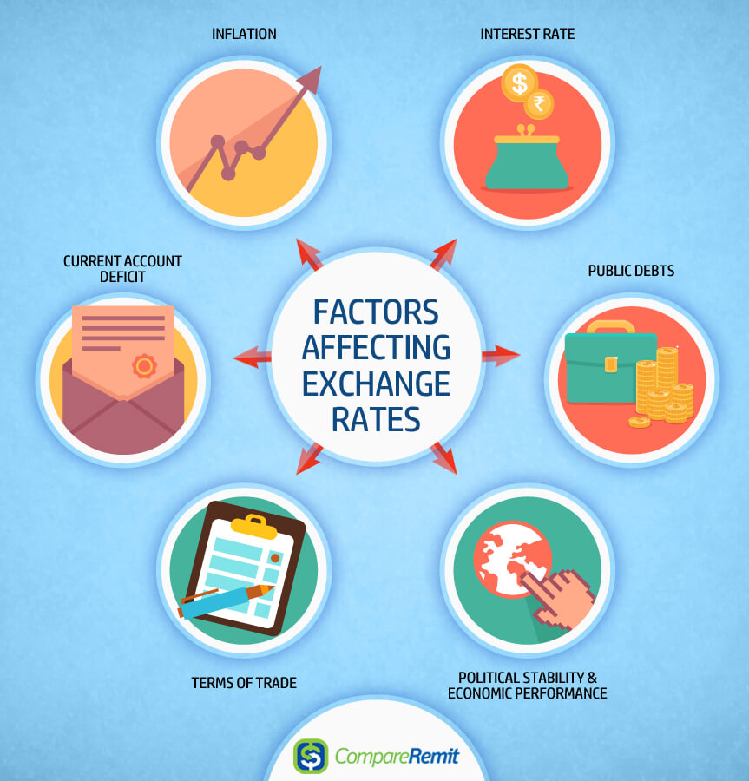

Slide 17
What influences Exchange rates
Changes in inflation
Lower inflation means higher currency value , higher inflation means lower currency value
Change in Interest Rates
Higher interest rates causes the exchange rate to rise, while lower interest rates decrease exchange rates
This does not always hold

Slide 18
What influences Exchange rates
Account Deficits
Deficits cause a greater demand for foreign currency which in turn lowers a countries exchange rate
Public Debt
This isn’t good for getting foreigners to invest.
Debt can have many risks, a few being the possibility of defaulting, increase supply of securities, and printing money.

Slide 19
What influences Exchange rates
Political Stability And Economic Performance
Strong economic countries that are in good political standing look better for investing. This increases foreign capital which increases exchange rates

Slide 20
What influences Exchange rates
Recession
Usually at this time interest rates fall which makes exchange rates fall
Speculation
If a country is expected to do well then it makes investors what to invest in that country. But the opposite happens when the country looks like it will do bad.

Slide 21
Cryptocurrencies-Bitcoin(5989.61) vs Gold(1275.75)

Slide 22
Sources
https://www.thoughtco.com/what-determines-an-exchange-rate-1147883
http://www.xe.com/currencytables/?from=USD
http://www.investopedia.com/terms/forex/f/foreign-exchange-markets.asp
https://www.compareremit.com/money-transfer-guide/key-factors-affecting-currency-exchange-rates/
http://www.investopedia.com/terms/s/spotexchangerate.asp
http://www.bis.org/publ/rpfx16.htm?m=6%7C381%7C677
https://www.barchart.com/forex/major-rates

