Slide 1

Chapter 10 - The Money Supply Process

Slide 2
10-1a Monetary Base
Monetary Base =
Currency in circulation + bank reserves + U.S. Treasury currency in circulation (primarily coins)
Referred to as “high–powered money”
$1 change in the monetary base results in the money Supply increasing by much more than $1
MB = C + R

Slide 3
10-1b Changes in the Monetary Base
The Fed can affect the monetary base through
  Changing banks reserve requirement
  Open Market Operations
  Operating the discount window
Also affected by commercial banks and the cash-holding public

Slide 4
10-2a How the Nonbank Public Affects the Monetary Base
The nonbank public can affect the monetary base in a variety of different ways.
As the nonbank public changes the amount of cash it holds, the amount of currency in circulation changes.
Changing the composition of the base rather than the size.

Slide 5
10-2b How the Treasury Affects the Monetary Base
Foreign Exchange Intervention: when the Federal Reserve Bank of New York sells dollars and buys yen, the monetary base is affected.
When the Fed buys the yen from a commercial bank, it deposits dollars into the bank’s account at the Fed, and bank reserves increase.
Treasury Deposits at the Fed - the monetary base is affected when the federal government makes purchases or collects taxes.
Treasury transfers funds between different accounts to ensure federal spending does not significantly affect the monetary base.

Slide 6

10-2c Deriving the Money Multiplier
Changes in the monetary base have a multiple or “snowball” effect on the overall money supply
Money supply = MsM x Monetary base

Slide 7
10-3a Change in Currency Ratio
The currency ratio is k, which is currency/deposit
Currency Ratio (K) = Currency (C)
Deposits (D)
Why might the currency ratio change? What is the ultimate impact of this change?
  Level of Financial Market Development
  Public Mistrust of Banks

Slide 8
10-3b Change in the Excess Reserve
The excess reserves ratio (r_{e} ) is the amount of excess reserves in the banking system relative to the amount of deposits
Inverse relationship between r_{e} and the money multiplier is that if banks are holding relatively more excess reserves, they are lending relatively less than before
Less bank lending means less new money is being created by banks and thus a smaller money multiplier

Slide 9
10-3c Change in the Required Reserve Ratio
The logic behind this inverse relationship between r_{r} and the money multiplier MM= ( 1/Required Reserve Ratio) is similar to that for r_{e}: If banks are holding more reserves, they are lending out less. Less bank lending means less new money is being created and thus a smaller money multiplier.
If the Required Reserve Ratio increases from 20% to 25%, the Excess Reserve would decrease. You deposit $100 in the bank. If the bank’s required reserve ratio is 20%, $20 must be keep in Reserve, allowing $80 to create new money. If the RRR increases to 25%, $25 must be keep in reserve, allowing $75.00 to create new money.
Changes in the required reserve ratio, which in the U.S. is set by the Federal Reserve, does not change often.

Slide 10
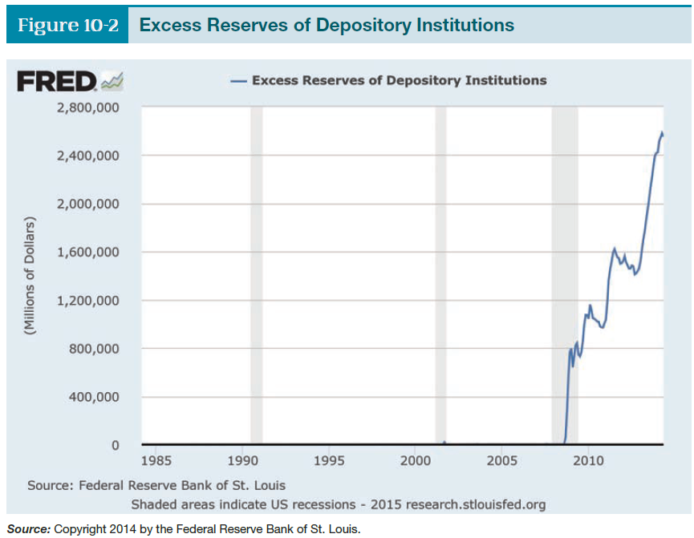
10-3d Money Supply Process & Quantitative Easing
Under quantitative easing the Fed
was buying a variety of financial assets
from commercial banks.
Thus banks saw their level of reserves
increase, but they did not significantly
increase their level of lending.
As a result, the level of the banks’
excess reserves increased dramatically

